Slide 1
ANALYSIS ON U.S. FLIGHT DELAYS
G1T6
Anant | Daniel | Ethan | Fangqi | Haodi | Kenneth Data: https://www.kaggle.com/usdot/flight-delays
Notes:
Good afternoon Prof and classmates, we’re Team 6 and today we will be talking about our analysis on flight delays in the US And we sourced our data from the Department of Transportation’s Kaggle page, this dataset has 5.82 million records, which is the same dataset as the earlier group

Slide 2
01
02
03
04
INTRODUCTION
EXPLORATORY ANALYSIS
Description of problem and project motivations
Descriptive analysis for trends & insights
PREDICTIVE ANALYSIS
DISCUSSION & CONCLUSION
Feature engineering & model evaluation
Application of results, limitations & future extensions
Notes:
We will first go through the introduction followed by exploratory analysis, predictive analysis and finally the discussion and conclusion

Slide 3
01
INTRODUCTION

Slide 4


U.S. Domestic Aviation Industry
$135 billion industry
in 2015
696.2 million domestic enplanements
$150 billion rise forecasted in 4 years
5.5% rise in demand from 2014
Notes:
The US Domestic Aviation Industry is worth about 135 billion and is expected to raise to about 150 billion in 4 years In the US alone, there are 696.2 million domestic enplanements, this means to say that even though the US population is about 390 million there are people that travels more than once per year domestically, this also accounts for foreigners travelling domestically https://www-statista-com.libproxy.smu.edu.sg/statistics/197790/us-airline-domestic-passenger-enplanements-since-2004/

Slide 5


Aviation Industry Costs
>15 min delays costed the aviation industry $28 billion
High fixed costs in the industry
Notes:
The aviation industry is an industry with high fixed costs which means it has a higher barrier of entry The FAA considers a delay being anything beyond 15 mins and according to our research, delays of more than 15 mins has cost the aviation industry more than 28 billion

Slide 6

Objective: Minimize Delays and Costs
Average cost of airblock time for US airlines: $74.24 per minute Average value of passenger’s time: $47 per hour
Total: ~ $75 per minute
Notes:
Our objective of this project is to minimize delays and in turn minimize cost as it costs about $75 per minute of delay And the cost savings could potentially save an airline from black swan events or rainy days such as the COVID 19 pandemic

Slide 7
02
EXPLORATORY ANALYSIS

Slide 8
Objective
Understand the dataset and Extract insights from the data
Pre-process the data
Summary statistics of the data
Understand airline and industry performances
Correlations amongst variables
Explore potential reasons for delays
Notes:
Our objective for the EDA phase is to pre-process the data, get a summary statistics of the data Understand the industry and find the correlations amongst the variables and also explore potential reasons for delays

Slide 9
Data Pre-processing
Airport ID to
IATA Code
Imputation of Missing Values
Data Type Conversion
Ensure all airports are represented in the IATA code format
Columns with missing values represent delay durations →
Impute with zero
Change certain variables to factor and character variables
Dataset
Subsetting
Convert
time features
Remove flights that are cancelled or diverted
Misrepresentation of time as numeric values (00:05 -> 5)
→ Convert to decimals in [0,24)
Notes:
For Data Pre-processing We made sure the airport codes are represented in the same format which is the IATA Code format Impute missing values Convert variables to factors or characters wherever necessary Subsetted the data to focus on what we needed And convert the time features to something more comprehensible

Slide 10
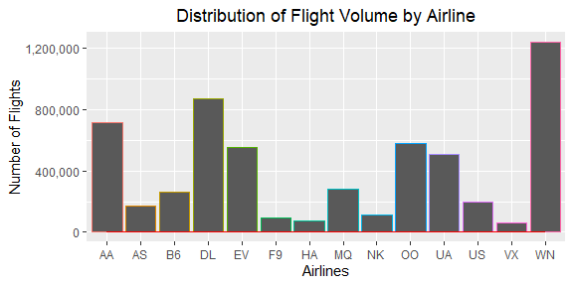



Local Market Share Distribution [by volume]
Notes:
From the data, we derived the largest domestic airlines by volume in US Which is, Southwest Followed by Delta and American Airlines

Slide 11



Local Market Share Distribution [by volume]
23%
15%
12.5%
Notes:
Southwest has the largest local market share with 23% Followed by Delta with 15% and American Airlines with 12.5% respectively

Slide 12
Class Distribution of Flight Delays
Definition of Flight Delay
FAA’s Guideline: 15 minutes or more past scheduled time
Departure Delay
17.7%
Arrival Delay
17.91%
Notes:
So in accordance to the FAA’s guidelines, we define a delay as being delayed for more than 15 minutes With this, we found that 17.7% of the flights have more than 15 mins of departure delay and 17.91% of the flights have an arrival delay of more than 15 mins

Slide 13

Correlation between Departure and Arrival Delay
Correlation value: 0.9446715
If the plane arrives early, it would usually depart on schedule or early However, if the plane arrives late, there is a higher probability that it would have departed late as well
Notes:
The correlation for departure and arrival delay is at 0.944 which is quite a strong correlation In other words, if the plane arrives early, it would usually depart on schedule or early However, the opposite is true, if the plane arrives late, there is a higher probability that it would depart late as well

Slide 14
Our Focus
Departure Delay
Arrival Delay
Significance of departure delay to passengers and airlines
Notes:
So out of the 2 types of delay, we choose to focus on the departure delay This is because, in the case of an arrival delay, the customers would have already been accustomed to the airplane settings and at the same time, the plane is actually not stationary Whereas in the case of a departure delay, the passengers are seated on the plane stationary while just waiting to depart and even waiting at the gate lounge. This badly erodes customer experience
Which is why we want to focus on departure delays as it largely contributes to the overall experience of the passengers. This would potentially help maintain an airline maintain it’s reputation.

Slide 15
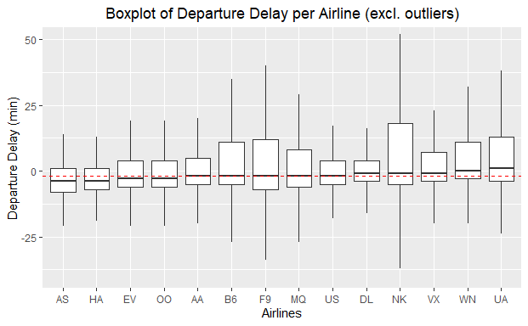
Deep Dive
Overall median departure delay in minutes [represented by the red-dotted line]
Notes:
As mentioned earlier, Southwest has the biggest marketshare in terms of volume in the US However, when we compare the overall median vs southwest’s median, it seems like they are lacking in terms of departure delay since their median is slightly higher than the overall median We want to target southwest because we believe that having a better management of departure delays could help maintain their market share as it contributes to the overall customer experience

Slide 16

What Contributes to Southwest Departure Delay
Hypothesis 1: Busier airport → more delays Hypothesis 2: Travelling season → more delays
Notes:
So we tried investigating what contributes to Southwest’s Departure Delay And we came out with 2 hypothesis, 1) Having a busier airport = more delay 2) When it’s the travelling season = more delay

Slide 17
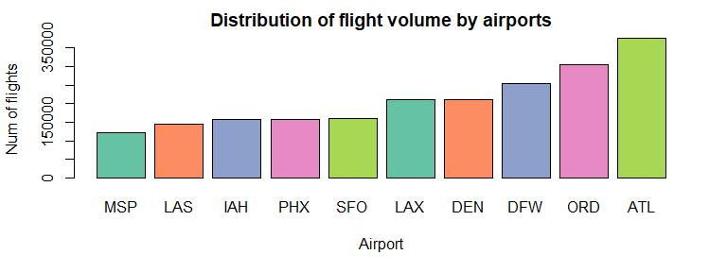
Hypothesis 1: Busier Airport → More Delays
Notes:
Based on our earlier investigations, we found that ATL airport has the most number of flights And Minneapolis airport has lower number of flights within the range

Slide 18
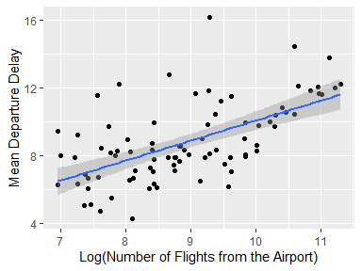
Hypothesis 1: Busier Airport → More Delays
Notes:
We then plot a scatter plot with the best fit line between number of flights to an airport and the mean departure delay Most of the mean departure delay is along the best fit line but there are still quite a number of outliers

Slide 19

Hypothesis 1: Busier Airport → More Delays
Busiest Airport - ATL, Hartsfield Jackson Atlanta International Airport
Mean Departure Delay: 12.1 minutes
Percentage of departure delayed flights: 22.75%
Lower frequency airport - Minneapolis−Saint Paul International Airport
Mean Departure Delay: 8.03 minutes
Percentage of departure delayed flights: 16.79%
Moderate Correlation between Frequency and Departure Delay: 0.6049447 Conclusion: Level of busyness of airports contributes to departure delay
Notes:
For Atlanta, the mean departure delay is 12.1 minutes With 22.75% of the flights being categorized as late For Minneapolis, the mean departure delay is 8.03 minutes And only 16.79% of the flights were categorized as late The correlation between frequency of flights and departure delay is 0.6049447 What this means is, the level of busyness of the airport contributes to departure delay

Slide 20
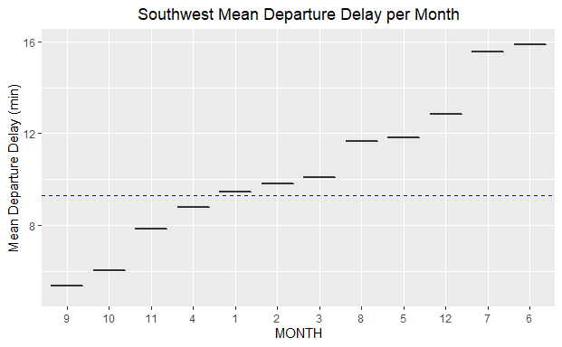
Hypothesis 2: Seasonality
Notes:
Hypothesis 2, does seasons affect delays?
These are the months where the delays is above the overall mean departure delay It turns out that departure delays are often higher from December to March and then from May to August Sounds familiar? These are the holiday seasons

Slide 21


Hypothesis 2: Seasonality
Holiday/Vacation Season = Huge Influx of people flying
Months with mean departure delay more than overall mean departure delay:
DEC
JAN
FEB
MAR
MAY
JUN
JUL
AUG
Winter Festivities + Spring Break
Summer Break
Notes:
This meant that a huge influx of people flying also constitutes to departure delays, now let’s move on to the predictive analysis portion

Slide 22
03
PREDICTIVE ANALYSIS
Notes:
After understanding the dataset and exploring possible reasons for the delay, we move on to build prediction models on top of we have discovered.

Slide 23
Objective
Aim to predict which flights will experience Departure Delay
Binary classification problem
Why not Regression?
Linear Regression: R² value < 0.2; RMSE: 23+ minutes
The exact number of minutes of delay may not be crucial
15-minute delay V.S. 18-minute delay is not much different
Notes:
Our goal is to predict whether a new flight will experience departure delay, which is a binary classification problem
You may wonder why we didnt approach this problem using regression. We indeed attempted linear regression model but the performance is very bad, seen from the v small R2 value and large RMSE. Moreover, we believe that the exact number of minutes of delay may not be that crucial. A 15min delay and a 18min delay is not much different → therefore we proceed with the classification approach/

Slide 24
Data Splitting
60% Train
20% Validation
20% Test
Exploration
Model and Feature Explore
Hyperparameter Tuning
Feature & Model Selection
Not Used
Final Model Building
Evaluate Performance
Final Feature Generation and Model Training
Notes:
As we will explore different features and models, to have an unbiased performance evaluation, we split the dataset into train validation and test sets with the ratio of 60-20-20.
The train set is used to explore different models and features; the validation set is used to select the best set of features, models and hyperparameters if applicable. The test set is only used for final evaluation after we train the best model with both train and validation sets.

Slide 25
Feature Selection
Availability of Data at Prediction Time
Predicting if a flight will depart late or not
Cannot use any post-departure data points
Primarily use scheduled features known before the time of a flight
E.g. scheduled_departure, scheduled_arrival, origin_airport, flight_number
Problem: Too few features!
Notes:
Next is feature selection. As our ultimate goal is to predict Departure delay of an unseen flight, we cannot use any features or data after the actual departure. I.E, we can only use the scheduled features → too few features for modelling → carry out feature engineering

Slide 26
Feature Engineering
Airport Freq Quantile
On-time Performance
Classify origin airports into quantiles according to frequency of flights in the training data
Proportion of delayed flights in training data for each flight number & each aircraft
Graph Features
Delay Variables
Use node centrality measures under the network analysis to capture different characteristics of origin airports
Aggregate delays with different causes (e.g. weather, security) by the appropriate features using mean
Notes:
There are the four main features we engineered.
Firstly, As we discover that busier airports tend to have more delays, we capture this characteristic using the flight frequency quantiles from the airports.
Also, We believe certain flights and aircrafts have a higher likelihood of delay regardless of the origin airports and so we created the feature, on-time performance as the proportion of delayed flights among the traning data.
Next, Given that the flights and airports form a network, and some airports are actually hubs and some may be connected to different clusters of airports. Therefore we computed the various node centrality measures to capture different characteristics of origin airports.
Last but not least, our dataset actually contains delay durations under different causes, such as weather or air system delay. So we aggregated to the appropriate level, such as by airports with mean as a new feature.

Slide 27
Evaluation Metrics
Area under
Receiver Operating Curve (AUC)
Precision
Recall
F1-Score
Overall expected model performance irrespective of threshold set
Proportion of predictions are actually true
Proportion of all actual positive labels are predicted
(True Positive Rate)
Conservative average of Precision and Recall
Notes:
The performance metrics we used are AUC, Precision, Recall and F1-score, with the AUC as the main metric.

Slide 28


Candidate Models
Logistic Regression
Classification Tree
Hybrid of forward and backward selection for features to include in the model
Search for best cp value through maximizing AUC
Notes:
Knowing that regression models and tree based methods draw decision boundaries with different approaches, we explored one model under each type: LR and CT.
The reason why we didnt explore ensemble models such as RF is due to its limited interpretability and too long computation time, given our dataset contains more than 5 million of records.
For LR, we used the hybrid of forward and backward seelction to find the tbest features
For CT, we manually searched the best cp value with validation set AUC performance

Slide 29
Validation Set Model Performance
Model | AUC on validation set
Baseline (all classified as 0) | 0.50
Logistic Regression | 0.7179
Classification Tree (manual search of best cp = 0.00001) | 0.7131
Notes:
These are the validation set model performances.
The baseline is by classifying all records to the majority class, which is no delay.
Here we can see that even with the best cp parameter, LR still has a better performance in AUC → select as the final model

Slide 30
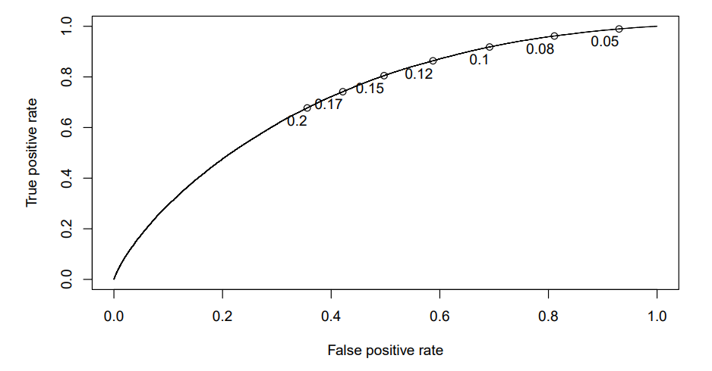
Final Logistic Regression Test Performance
AUC Score: 0.7185
Notes:
This the ROC curve of final LR regression on the unseen test set. from the curve, we can see that as the threshold increases, a unit decrease in FPR gives more decrease in TPR. Therefore we select the threshold to be 0.15 as it gives the best balance between TPR and FPR/

Slide 31
Final Logistic Regression Test Performance
Threshold = 0.15
Metric | Score
Precision | 0.2932
Recall | 0.8100
F1-Score | 0.4305
Confusion Matrix |  | Prediction
 |  | Delay | No Delay
Actual | Delay | 40925 | 9596
 | No Delay | 98677 | 99226
Notes:
These are the confusion matrix and other performance metrics on the test set with the 0.15 threshold. As you can see, the recall is very high but the precision is low. We will talk about them more in the discussion later.

Slide 32
04
DISCUSSION & CONCLUSION
Notes:
We now move on to the discussion of the relevance and application of our results

Slide 33
Applications
For Southwest Airline
For All Airlines
Use prediction output to pre-empt flight delays and put in place measures to reduce delay likelihood
→ Sustain industry leader position
Similar models can be produced for other airlines, empowering better financial planning and forecasting for the companies e.g. estimating compensation amounts
Notes:
So, how can our analysis be useful to an airline company like Southwest?
Firstly, in the case of Southwest, the prediction output can be used by Southwest to pre-empt which of their scheduled flights are likely to face a delay of more than 15 minutes. By flagging out these at-risk flights, Southwest may be better able to put in place preemptive measures to reduce the likelihood of delay on the actual day of the flight. For example, the company may consider measures such as incentivising passengers to check in earlier to prevent delays from this aspect. Another possible measure could be to better manage customer expectations by notifying them beforehand that their flight is at risk of being delayed. For example, this risk of delay could be made known to passengers at the time of flight booking so that they are aware of the risk and can also plan their schedules accordingly, reducing opportunity costs to the passenger in the event of an actual delay. This ultimately can help Southwest reduce customer dissatisfaction and help it sustain its position as an industry leader in the domestic flights market
Next, apart from Southwest, other airlines could also develop similar models to predict likely delayed flights. The use of this is for better financial planning and forecasting. This is because airlines might have compensation policies for delayed flights, and also because, as mentioned at the start, delays often come with economic costs to the airlines. So by being able to predict delayed flights, airlines may be better able to estimate these costs for financial planning.

Slide 34
Limitations & Future Extension
2015 Data
Low Precision
Regression Model
More recent data would be more relevant
Unable to use ‘historical’ features with just one year’s worth of data
→ Perform similar analysis with more recent data, and with longer timeframe
Many False Positives might cause overestimation of costs, or unnecessary expense from measures put in place to reduce delay likelihood
→ One early indicator model, and another re-assessor model that considers more points of information available closer to flight date
Predict departure delay by the minutes
→ Useful information about severity of the flight delay
Notes:
I’ll move on to assess some of the limitations of our current analysis. Firstly, the dataset we used was from 2015 and only contained flight data from that year. So, more recent data may have provided more time-relevant output. Additionally, because data was only limited to 2015, we were unable to calculate ‘historical’ statistics, for example, the on-time performance of a similar flight or aircraft number in the past few years.
Thus, an extension could be to perform similar analyses using more recent data and with a longer timeframe, such as by getting 2015-2019 data.
Next, our predictive model actually has rather low precision, this means there may be many false positives which might cause an overestimation of costs for an airline company. This might also lead to unnecessary expenses if the company chooses to act on the predictions and put measures in place to reduce likelihood of delay. Thus, a workaround to this is that the current model could be used as an early indicator model that flags out these at-risk flights for budgeting and financial planning, while a second re-assessor model could be developed that may then incorporate more points of data that may be known closer to the flight date, such as weather conditions or passenger data and demographics. This could thus allow the airline to confirm again if measures need to be put in place.
Lastly, an extension of this project could be to develop a regression model that can predict departure delay by how many minutes a flight may be delayed. Such an output may provide more useful information about the severity of the flight delay, especially when delay compensation policies are tiered and offer different compensation amounts according to severity of the delay.

Slide 35
Conclusion
Industry & Competitor Analysis
Factors Affecting Delays
Predicting Delays
Flight volume and on-time performance
E.g. Seasonality, Airport Popularity
Binary classification logistic regression model
Empower Southwest & other airlines to pre-empt delays and take action beforehand
Potential to save costs for both airlines and passengers
Notes:
In conclusion, our project looked at the flight data to firstly compare how Southwest, the domestic industry leader in both market share and flight volume, was doing in comparison to its many competitors in terms of on-time departure performance. Then, we examined what are some of the factors that might contribute to delays in departure and found that the month of the flight, as well as the busyness of an airport, do correlate with departure delay times. Subsequently, we created a predictive logistic regression classification model that could help airlines flag out scheduled flights that are at risk of departing more than 15 minutes late.
We believe our analysis has the potential to empower Southwest as well as other airlines to pre-empt delays in their flights and take action beforehand to minimize the likelihood as well as severity of the delays, which ultimately has the potential to save costs for both airlines and the passengers.

Slide 36

THANK YOU
Notes:
We have come to the end of our presentation. Thank you for your attention!

